Slide 1

The International Power Rangers present
WHO IS THE
REAL POWERHOUSE?

Slide 2

An Explorative Analysis
of
Global Energy Production
by Nick, Mike, Aline & Carly
Notes:
It’s a power-hungry world that we live in. Everyone needs it to live but how do we make it? The answer is powerplants, and lots of them!
In this analysis we will deep dive into how the world produces its power. who produces the most and who is the cleanest, we will see how developed countries stack up against developing in their production and their sustainability

Slide 3
How to discover the real powerhouse?
We are currently facing a global energy crisis caused by world population growth, an escalating increase in demand, and continued dependence on fossil-based fuels. For many people this isn’t a concern for them, and they wouldn’t typically worry about it too much. Its only when the power gets shut off (happening in multiple countries around the world) that people start noticing. In this analysis we are aiming to give the common person an insight into what fuels the worlds power plants that produce our power and how countries or different economic status compare to each other in their power production as well as use of sustainable sources. So that people are equipped with the knowledge to question and challenge government and world leaders to do better.
Questions:
What are the most commonly used power sources for power plants globally?
Do developing or developed nations produce more power per capita?
Do developing or developed nations use more renewable or non- renewable energy sources for powering their powerplants?
Google API plot energy plants

Slide 4
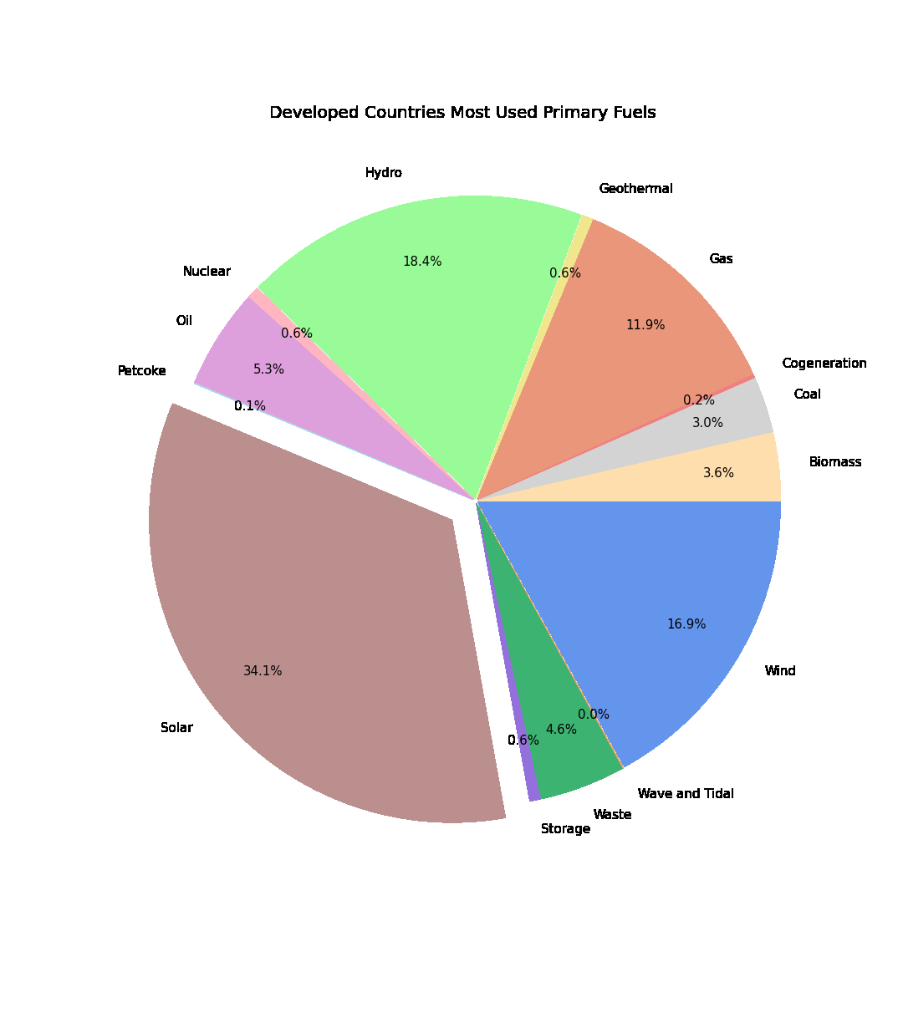
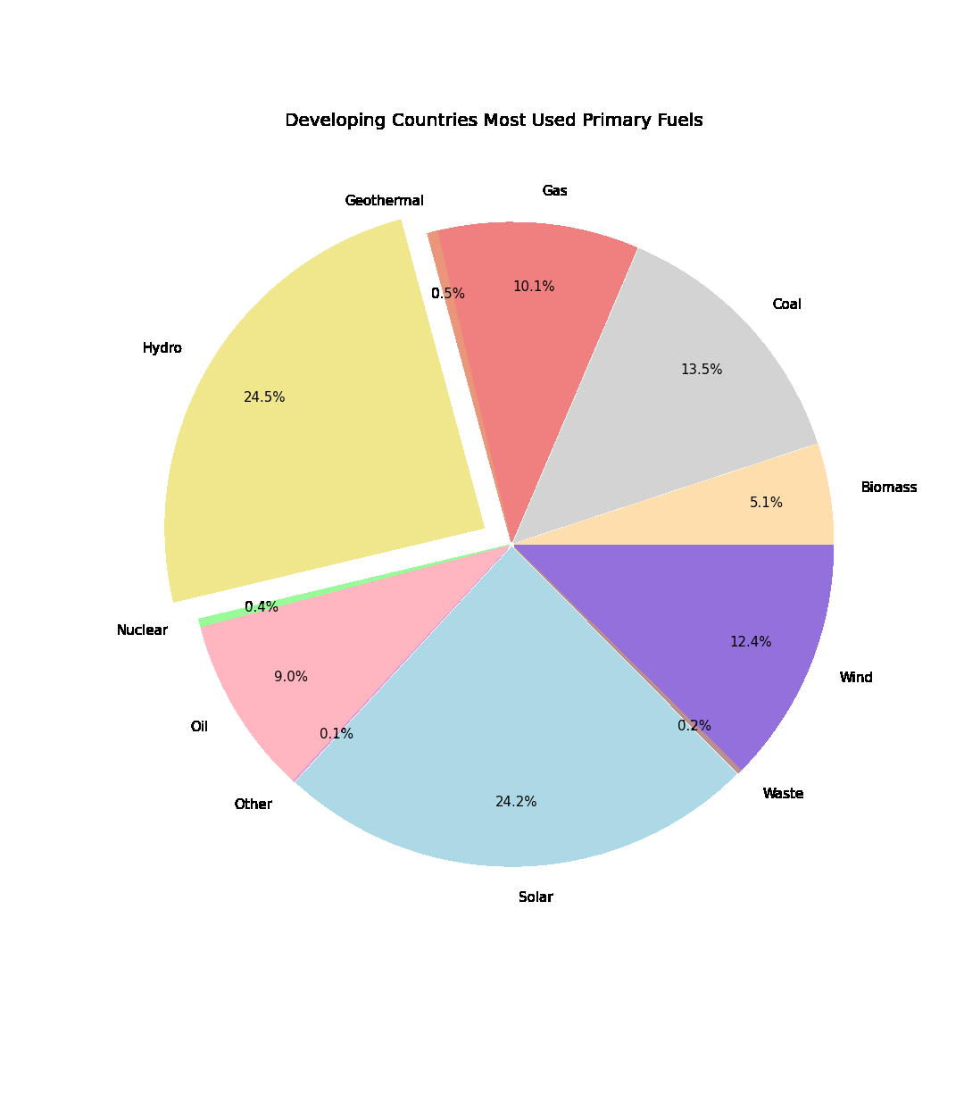
What are the most commonly used power sources globally?

Slide 5
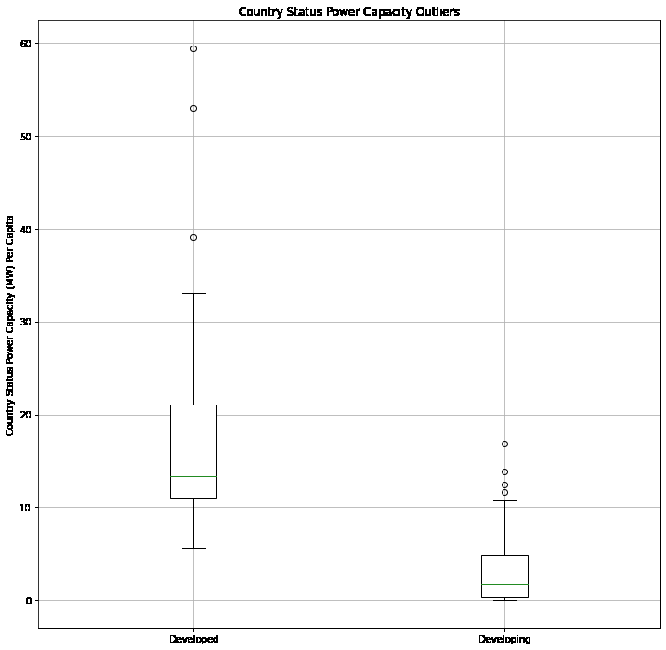
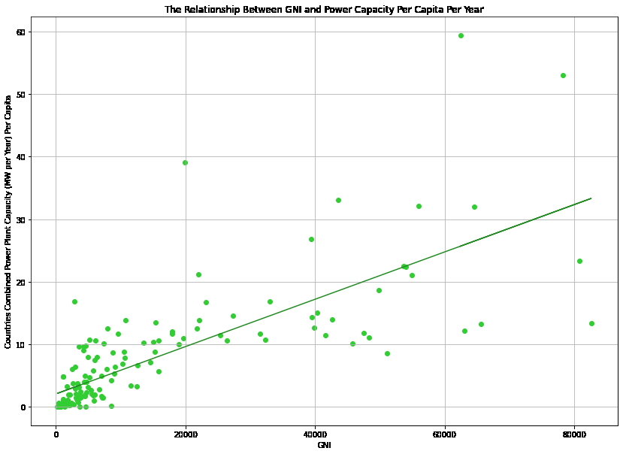
Do developing or developed nations produce more power per capita?

Slide 6
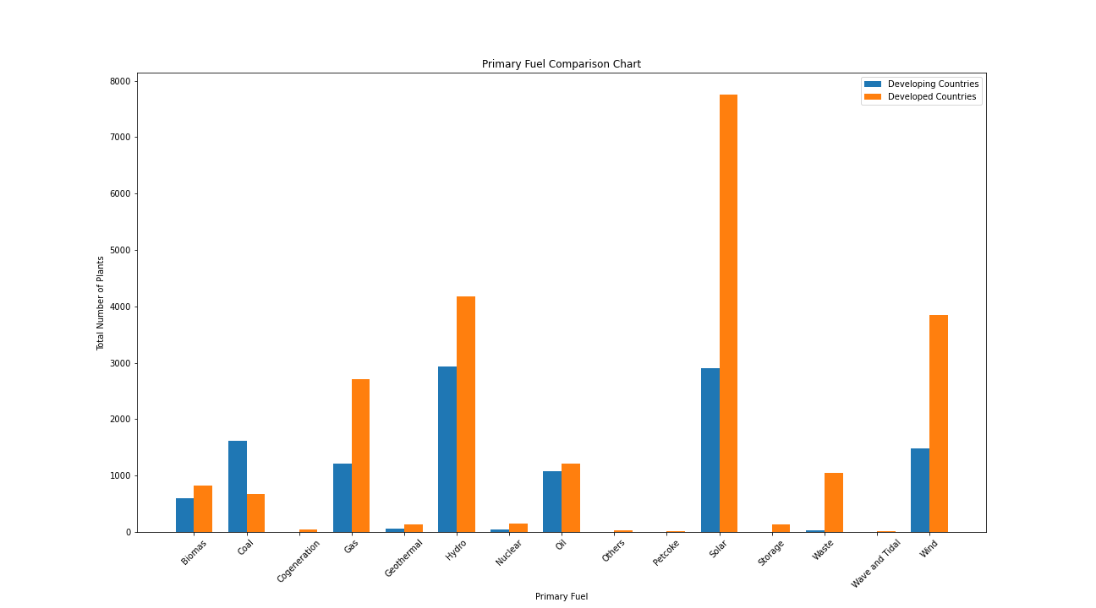
Do developing or developed nations use more renewable or non- renewable energy sources?

Slide 7
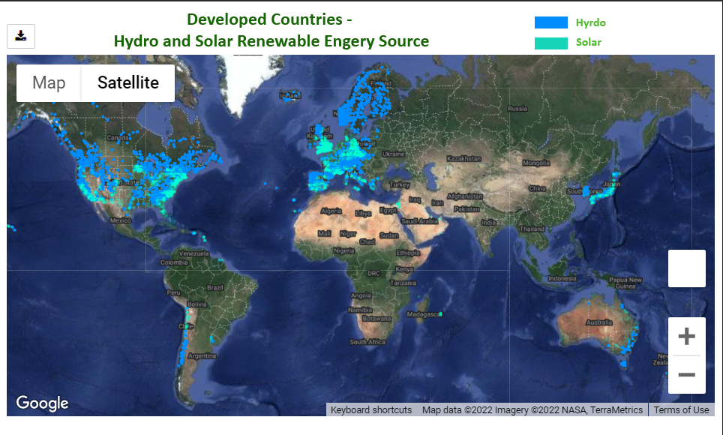
Google API plot energy plants

Slide 8
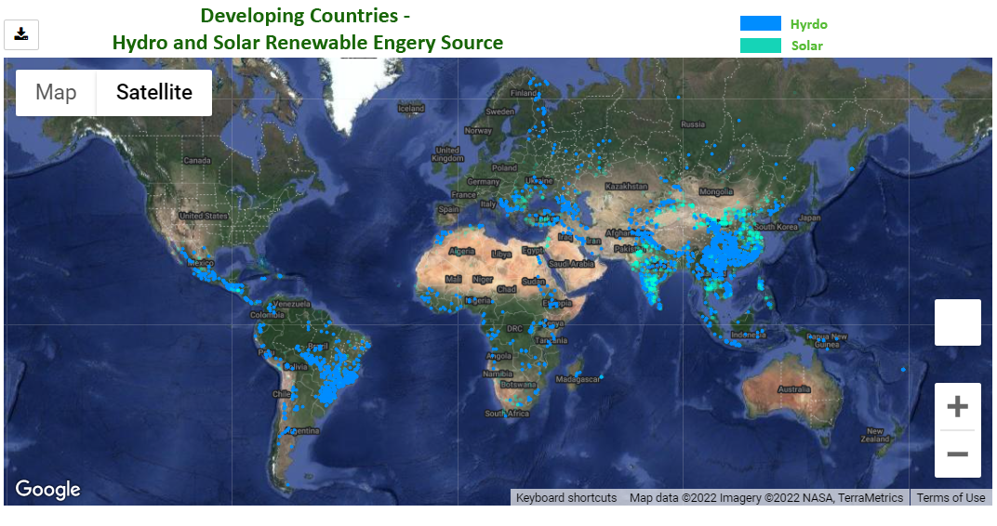
Google API plot energy plants

Slide 9
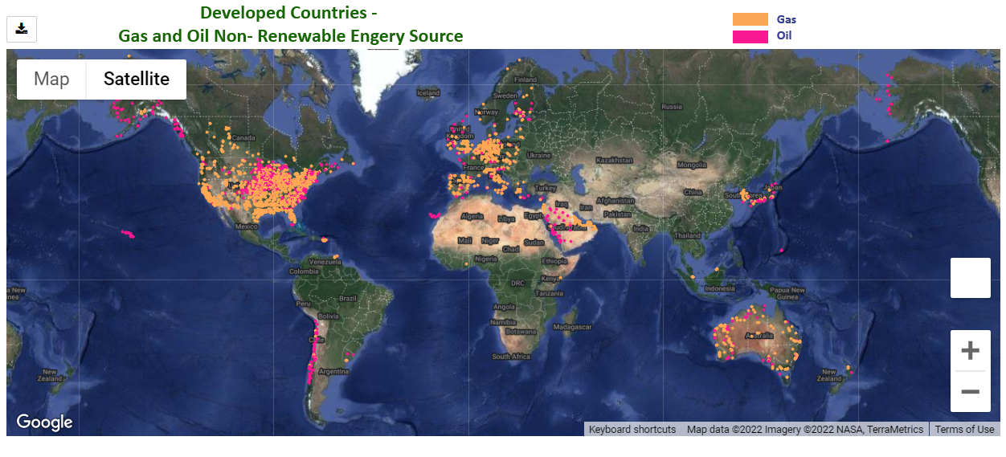
Google API plot energy plants

Slide 10
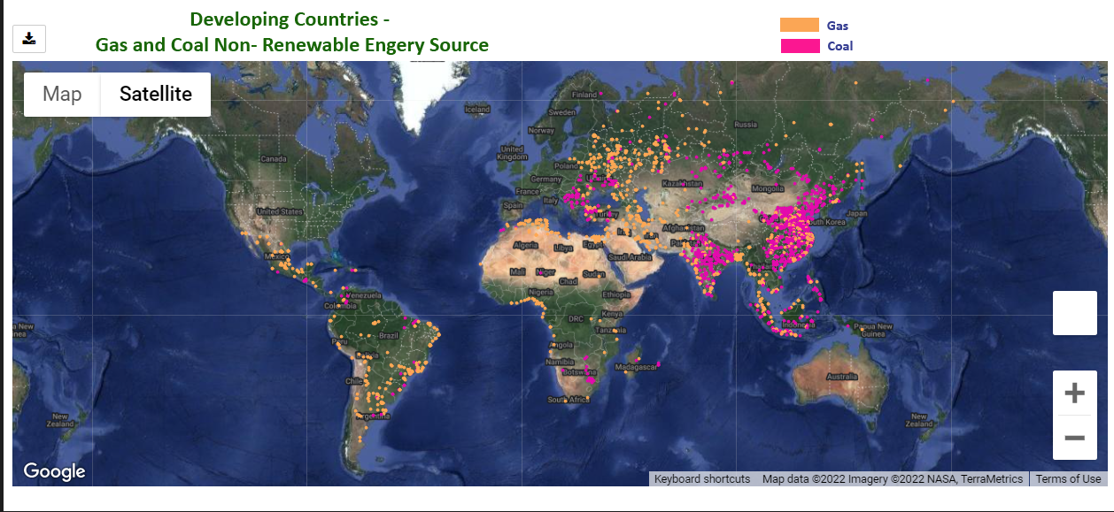
Google API plot energy plants

Slide 11
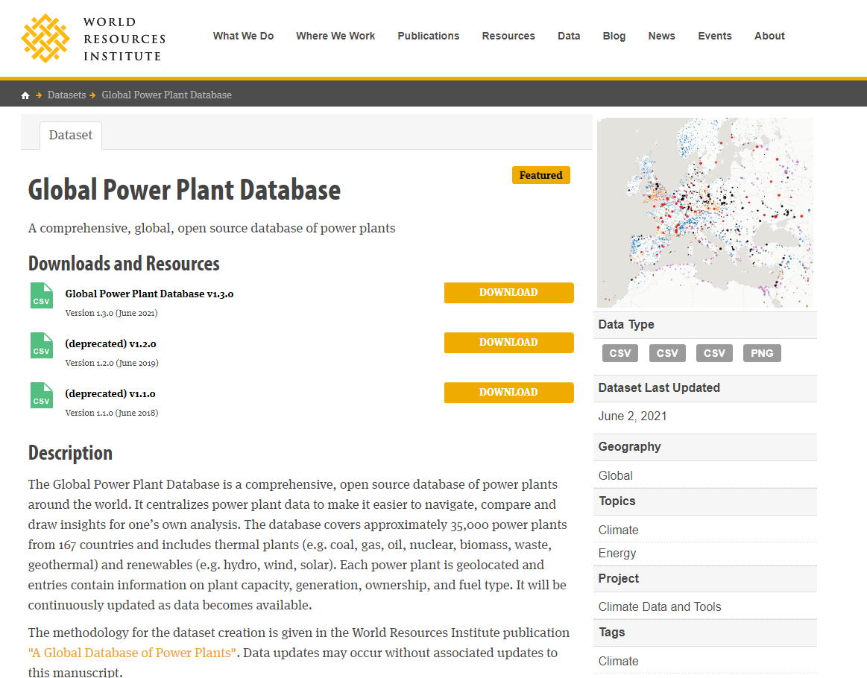
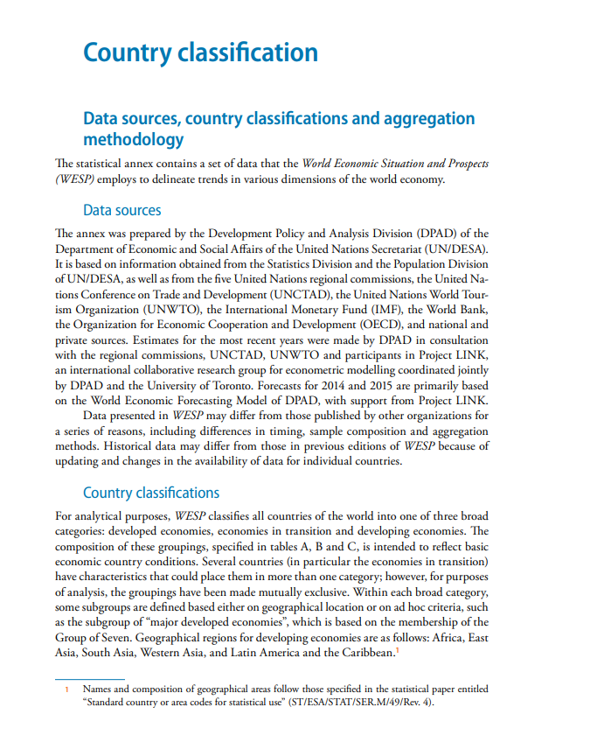
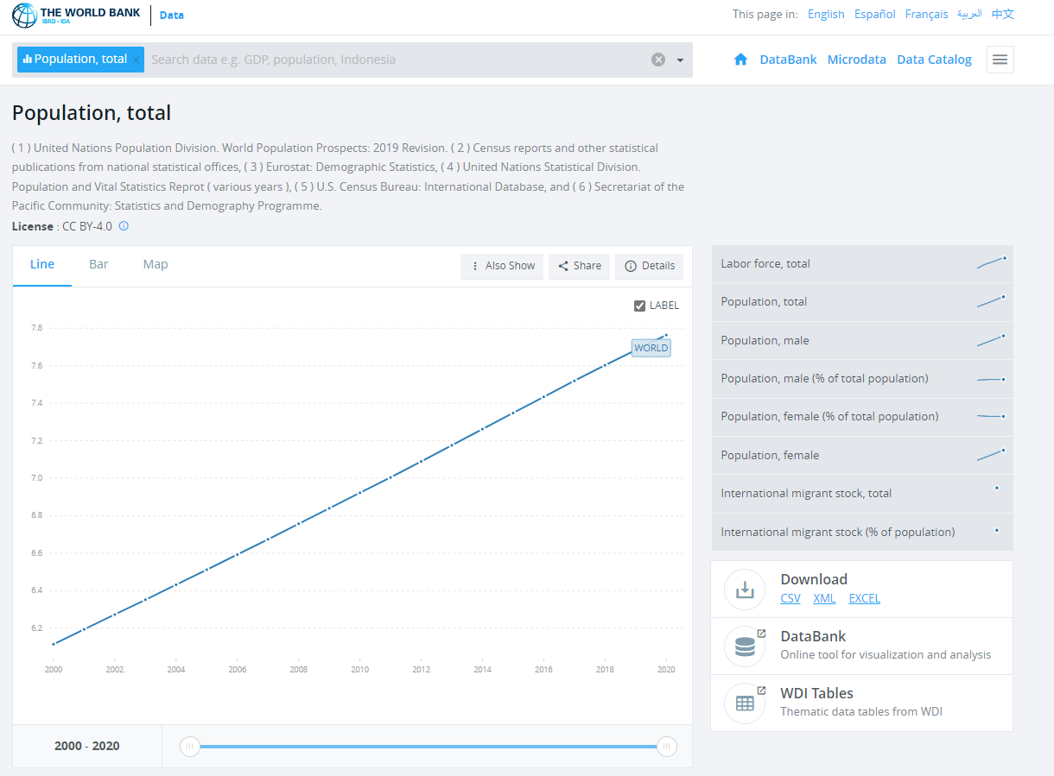
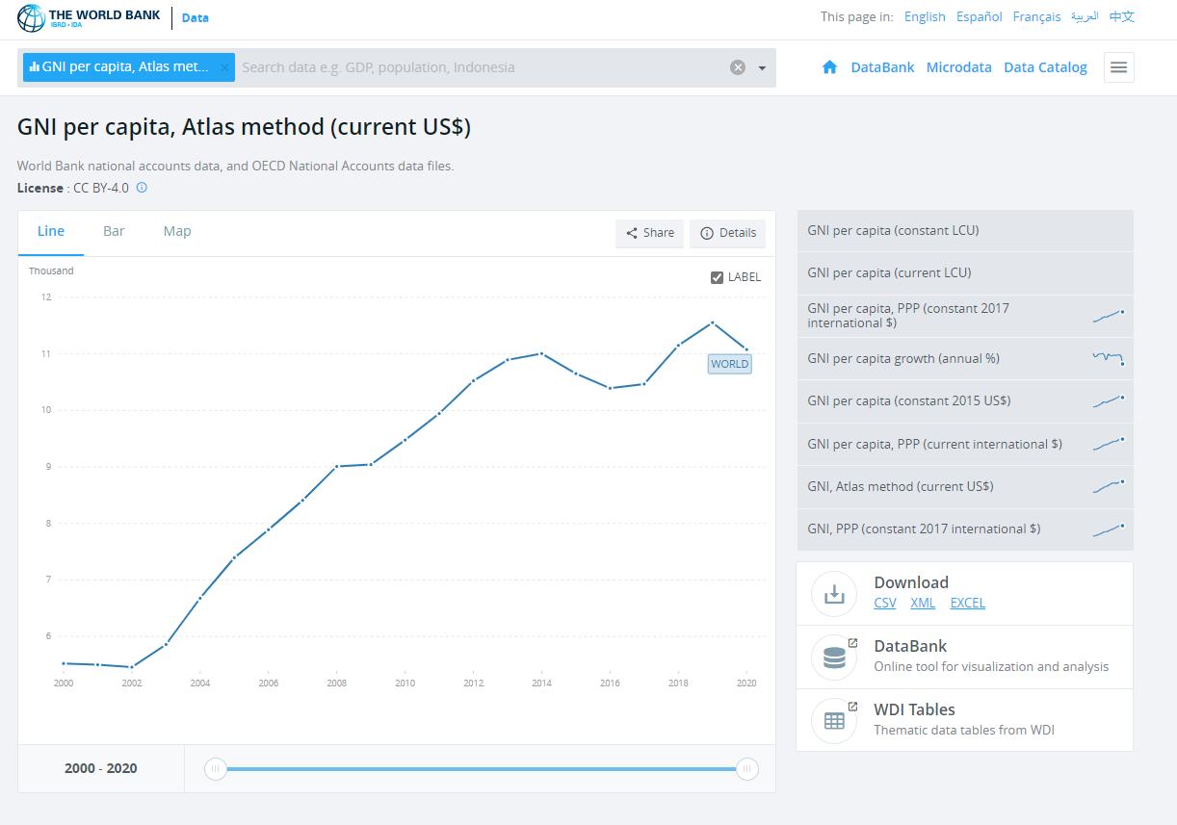
Data Exploration / Sourcing

Slide 12
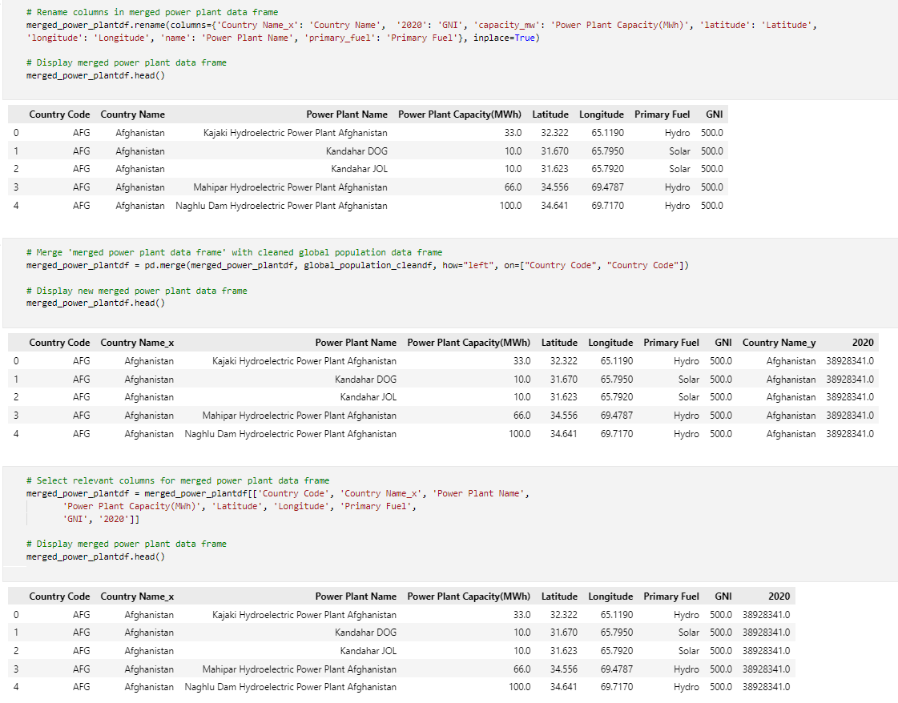
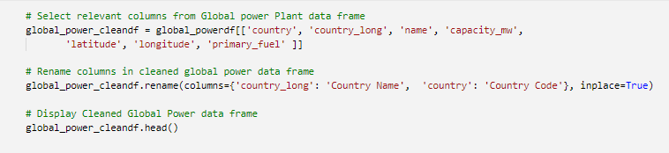
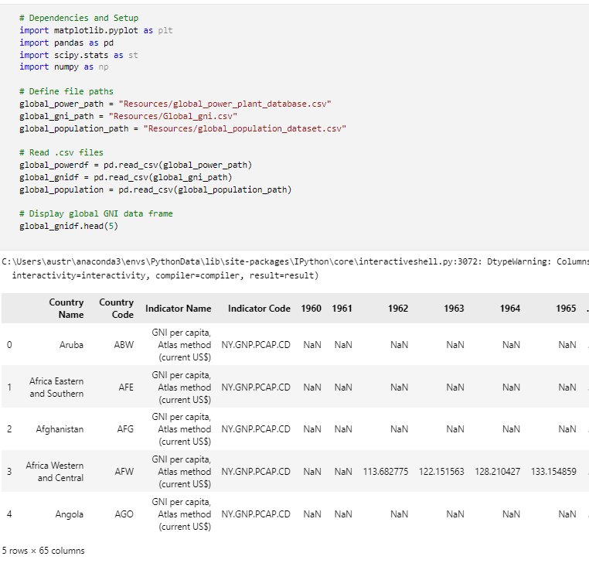
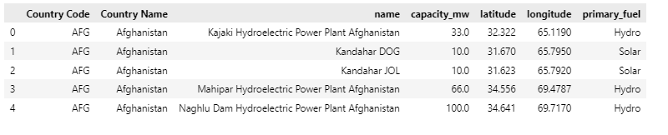
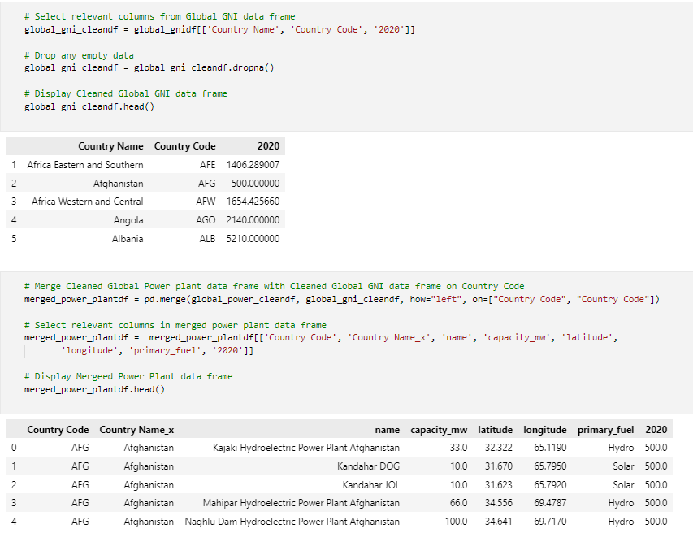
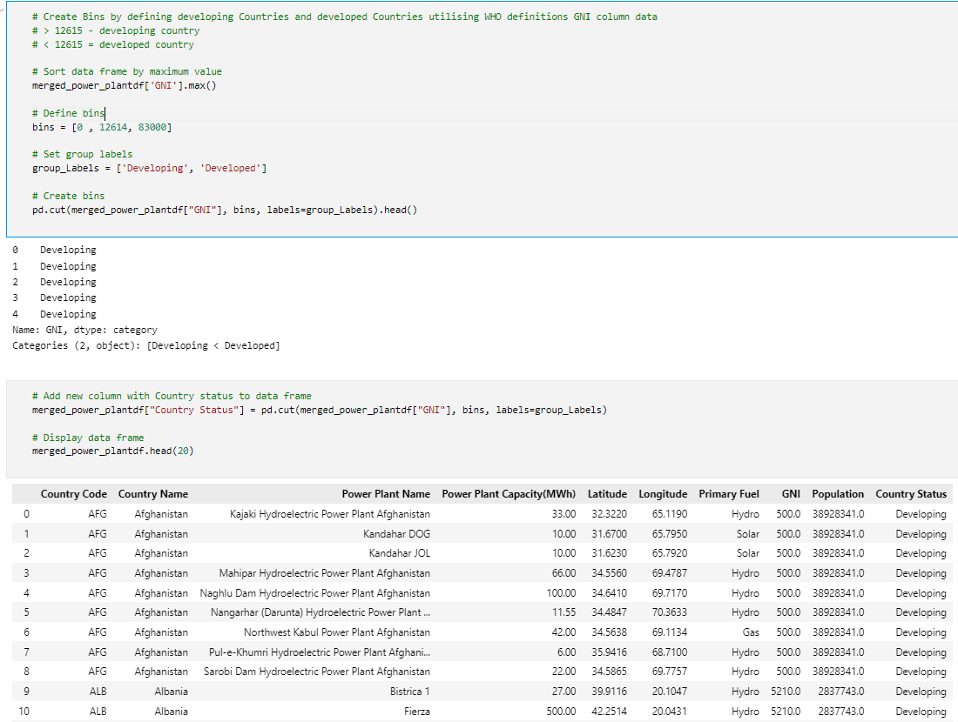
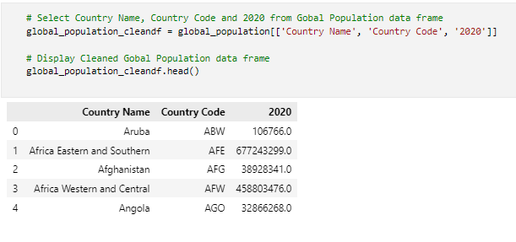
Data Cleaning

Slide 13
So???
Why should you care???

Slide 14
Questions?

Slide 15
Thank you! ☺

